Slide 1



x ⁰
P ⁰
x ⁰
P ⁰
u^{t}
u^{t}
g, K
y ^{t}
y ^{t}
k, $η, θ$
c ^{t}
c ^{t}
$η, θ$
╳
x ^{t}
P ^{t}
x ^{t}
P ^{t}
A)
B)
x ⁰
P ⁰
g
u^{t}
u^{t}
u^{t}
u^{t}
x ^{t}
y ^{t}
K
y ^{t}
y ^{t}
y ^{t}
x ^{t}
x ^{t}
c ^{t}
c ^{t}
$η, θ$
c ^{t}
c ^{t}
x ^{t}
P ^{t}

Slide 8
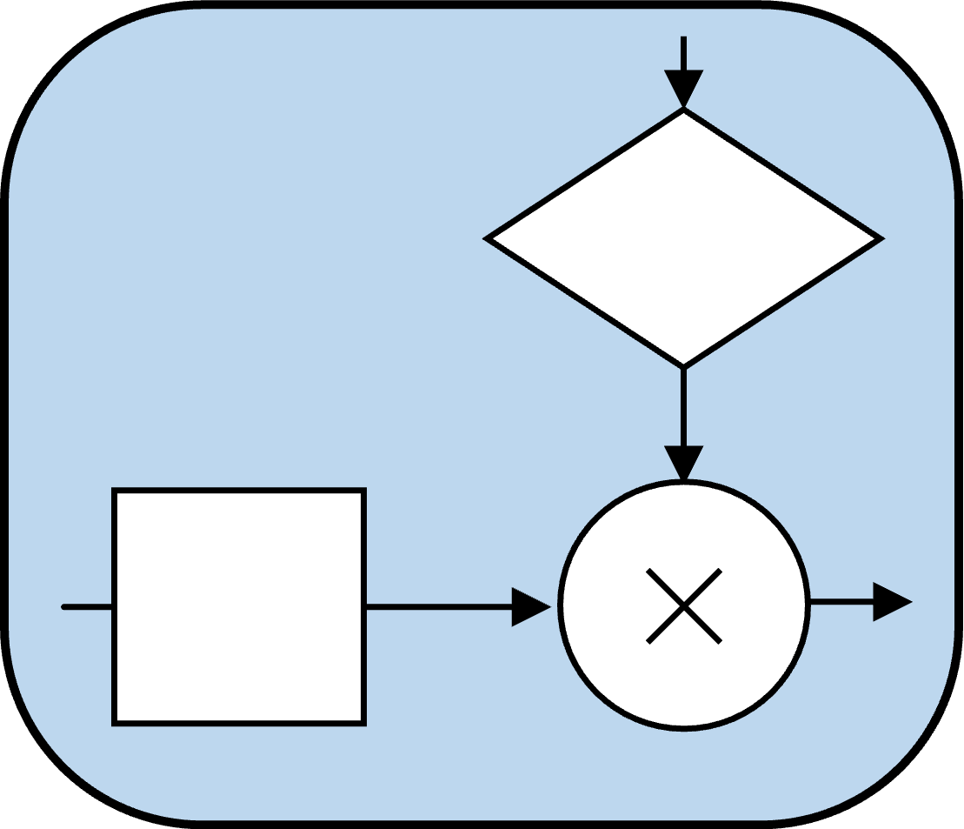
k_{𝜇𝜈}
d_{𝜇𝜈} ^{t}
>η ?
s_{𝜇𝜈} ^{t}
v ^{t}
q_{𝜇𝜈} ^{t}
v ^{t}
k_{𝜇𝜈}
select
╳
╳
synapse_{𝜇,𝜈}

Slide 9
k_{f}
k_{f}
d_{f} ^{t}
d_{f} ^{t}
>η ?
>η ?
s_{f}^{t}
s_{𝜈} ^{t}
s_{1𝜈} ^{t}
s_{1𝜈} ^{t}
. . .
s_{s𝜈} ^{t}
v ^{t}
q_{1f} ^{t}
k_{1𝜈}
q_{f}^{t}
╳
v ^{t}
v ^{t}
v ^{t}
q_{2f} ^{t}
k_{2𝜈}
╳
select
select
q_{f}^{t}
. . . . .
. . . . .
v ^{t}
q_{sf} ^{t}
k_{s𝜈}
╳
distal segment_{𝜇}
distal segment_{𝜇}

Slide 10
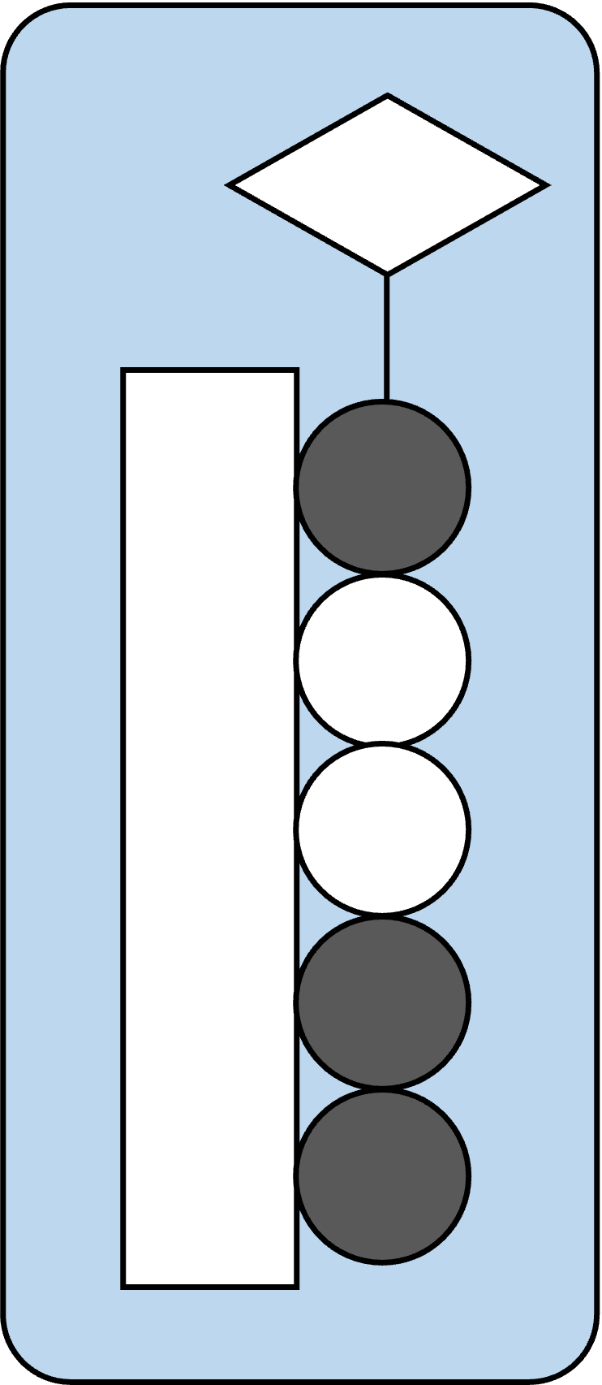
. . .

Slide 11
Synaptic Field
s_{r} ^{t}
d_{f} ^{t}
s_{r} ^{t}
>η ?
q_{f} ^{t}
v ^{t}
select
k_{f}
f: field index

Slide 12
Synaptic Bamk
a)
b)
K
K
c
Z
select
c
Z
q₁
q₂
Q
W
Q
P
η
. . .
W
P
q_{d}
W

Slide 13
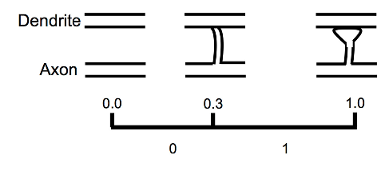
Synapse and Synaptic Region
a)
b)
k_{r}
k
c ^{t}
s_{r} ^{t}
c
s
select
p
w_{r} ^{t}
d
η
w
p_{r} ^{t}
d_{r} ^{t}
w_{r} ^{t}
w
p
w
0
η
1
p
f: field index

Slide 14
Synapse and Synaptic Region
a)
b)
k
k
c
z_{r}
c
z
select
p
w_{r}
q
η
q_{r}
w
p_{r}
w_{r}
w
p
w
0
η
1
f: field index

Slide 15
Block Diagram of Synapse
context
index
k
pre-synaptic
signal
k
context
c
z
select
c
z
p
q
p
q
η
╳
w
permanence
post-synaptic
effect
synaptic
weight
w
f: field index

Slide 16
k_{𝜈}
d_{𝜈} ^{t}
>η ?
v ^{t}
k_{1𝜈}
select
╳
v ^{t}
v ^{t}
k_{2𝜈}
select
v ^{t}
s_{𝜇𝜈} ^{t}
v ^{t}
q_{𝜇𝜈} ^{t}
k_{𝜇𝜈}
v ^{t}
k_{s𝜈}
select
synapse_{𝜇,𝜈}

Slide 17
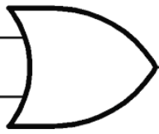
g
group index
c ^{t}
z_{g}^{t}
b ^{t}
y ^{t}
||⋅||₁ ≟ 0
×
output
p_{g}= 1
q_{g}^{t}
burst
u ^{t}x ^{t}
OR
w_{g}
1
z’
(u ^{t’}x) ^{t’}
u ^{t}
input
×
context index
K
c ^{t}
Z ^{t}
Figure 5: basic states of the Neurotron
pre-synaptic signal
context
x ^{t+1}
x ^{t}
||⋅||₁ ≥ θ
1
Q ^{t}
z
state
W ^{t}
synaptics
(post-synaptic
effects)
-
𝛿 ⁺
Σ
𝛿 ⁻
P ^{t}
P ^{t+1}
ΔP ^{t}
1
Σ
×
permanence
z
learning

Slide 18
m× n matrix: n columns, each containing m rows
column j
contains
m
neurons
. . . . . . . . . .
(n-1)m
+1
1
m+1
2m+1
2
m+2
2m+2
. . . . . . . . . .
(n-1)m
+2
...
...
...
...
row i
(j-1)m
+i
m
2m
3m
. . . . . . . . . .
nm
u₁^{t}
u₂^{t}
u₃^{t}
u_{j}^{t}
u_{n}^{t}

Slide 19
m
m
m
m
m
m
m
m
m
m

Slide 20
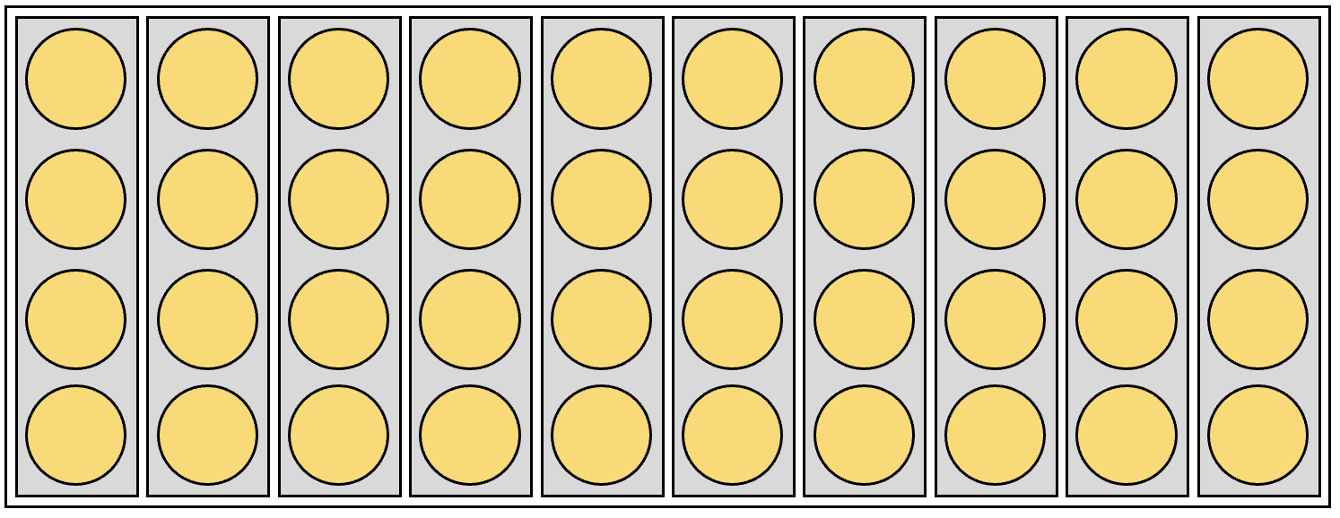
X ⁰
P ⁰
u^{t}
Y ^{t}
c ^{t}
X ^{t}
P ^{t}

Slide 21
X ⁰
P ⁰
u^{t}
Y ^{t}
r ^{t}
f ^{t}
c ^{t}
X ^{t}
P ^{t}
y ^{t}
( : )

Slide 22
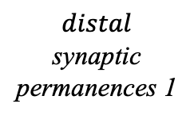
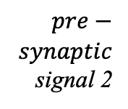


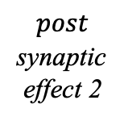
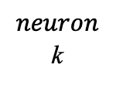
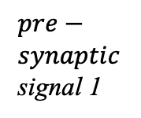
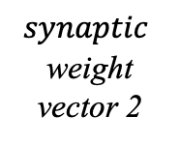
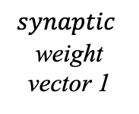
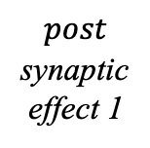

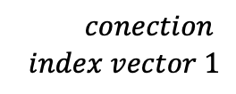


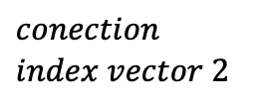


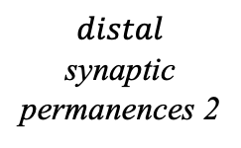


$$post$$
synaptic
effect 1
u_{k}
$$post$$
synaptic
effect 2
$$\left[{0 \atop \begin{aligned}1 \\ 1 \\ 0 \\ 1\end{aligned}}\right]$$
$$\left[{0 \atop \begin{aligned}1 \\ 1 \\ 0 \\ 0\end{aligned}}\right]$$
$$\left[{0 \atop \begin{aligned}0 \\ 1 \\ 0 \\ 0\end{aligned}}\right]$$
$$\left[{0 \atop \begin{aligned}1 \\ 1 \\ 0 \\ 1\end{aligned}}\right]$$
$$synaptic$$
weight
vector 1
q_{k2} =
$$synaptic$$
weight
vector 2
w_{k1} =
q_{k1} =
w_{k2} =
2
1
2
y₂ = 0
0.1
$$θ=2$$
0.2
y₃ = 1
3
c = y
5
y₅ = 1
0.5
0.8
y₄ = 0
4
c = y
$$neuron$$
k
7
y₇ = 1
0.8
$$2≥θ$$
0.7
y₇ = 1
7
$$context$$
$$context$$
8
y₈ = 1
0.3
0.3
y₉ = 1
9
11
y₁₁= 0
0.7
0.9
y₁₀ = 0
10
k_{k1}
z_{k1}
d_{k1}
y_{k}
p_{k2}
z_{k2}
k_{k2}
$$pre−$$
$$synaptic$$
signal 1
$$distal$$
synaptic
permanences 1
$$distal$$
synaptic
permanences 2
$$pre−$$
$$synaptic$$
signal 2
$$conection$$
$$index vector 1$$
$$output$$
$$conection$$
$$index vector 2$$

Slide 23
x ⁰
v ^{t}
t
1
D ⁰
x ^{t}
+
u^{t}
t
t+1
u ^{t}
u ^{t+1}
y ^{t}
y ^{t+1}
x ^{t}
x ^{t+1}
Q ^{t}
Q ^{t+1}
D ^{t}
D ^{t+1}

Slide 24
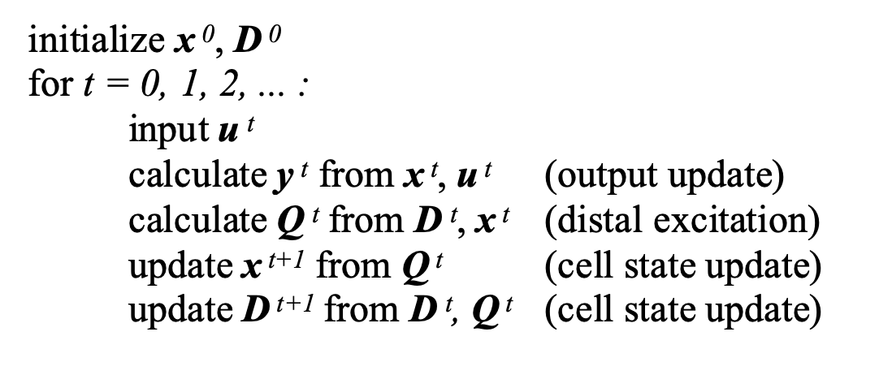
progress
progress
progress
0
t
t+1
input
input
calculate
output
input
u ⁰
u ^{t}
u ^{t+1}
Y ⁰
Y ^{t}
Y ^{t+1}
init
X ⁰
X ^{t}
X^{t+1}
state
update
Q ⁰
Q ^{t}
Q ^{t+1}
init
learning
P ⁰
P ^{t}
P ^{t+1}

Slide 25
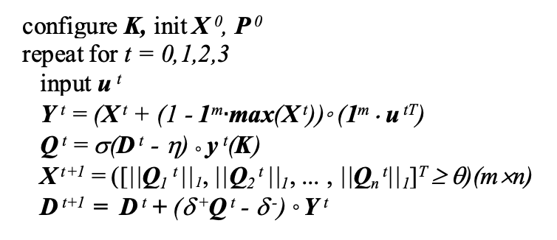

Slide 26
1
z
G
b^{𝜏+1}
b^{𝜏}
AND
OR
y^{𝜏}
AND
u^{𝜏}
s^{𝜏+2}
s^{𝜏}
c^{𝜏}
AND
Q
1
z²

Slide 27




